Slide 1

SWGDAM Update
ENFSI Meeting – April 2015

Slide 2
Outline
  Posting of Guidelines
  Enhanced Detection Methods Guidelines
  QAS Rapid DNA Addenda
  Serology Guidelines
  SWGDAM web site
  SWGDAM Committee/Working Group Updates

Slide 3
Posting of Guidelines
  All DRAFT SWGDAM guideline documents will be posted on SWGDAM’s web site for a 30 day public comment period (Comment page) and approved SWGDAM guidelines will also be available on the web site (Publications page).
  Please check the News & Information section on SWGDAM’s home page for new postings of interest regarding guideline documents and other SWGDAM work products.

Slide 4
EDM Guidelines
  SWGDAM Guidelines for Enhanced Detection Methods are available on the SWGDAM web site.
  The Guidelines were approved by the membership and posted for public comment during July/August 2014.
  The SWGDAM Executive Board approved the Guidelines following the public comment period with minor revisions to address the public comments.

Slide 5
QAS Rapid DNA Addenda
  The Addendum to the Quality Assurance Stands for DNA Databasing Laboratories for Rapid DNA Analysis and Modified Rapid DNA Analysis Using a Rapid DNA Instrument and the Addendum to the Quality Assurance Stands Audit for DNA Databasing Laboratories for Rapid DNA Analysis and Modified Rapid DNA Analysis Using a Rapid DNA Instrument are available on the SWGDAM web site.
  The QAS Rapid DNA Addenda were approved by the SWGDAM membership and posted for public comment during July/August 2014.
  The SWGDAM Executive Board approved the QAS Rapid DNA Addenda with minor revisions to address the public comments and the SWGDAM Chair forwarded these Addenda to the FBI Director for approval.
  The FBI Director approved the QAS Rapid DNA Addenda with an effective date of December 1, 2014.

Slide 6
Serology Guidelines
  The SWGDAM Guidelines for the Collection and Serological Examination of Biological Evidence are available on the SWGDAM web site.
  The Serology Guidelines were approved by the membership and posted for public comment during December 2014/January 2015.
  The SWGDAM Executive Board approved the Serology Guidelines with minor revisions to address the public comments at the January SWGDAM meeting.

Slide 7
Website

Slide 8
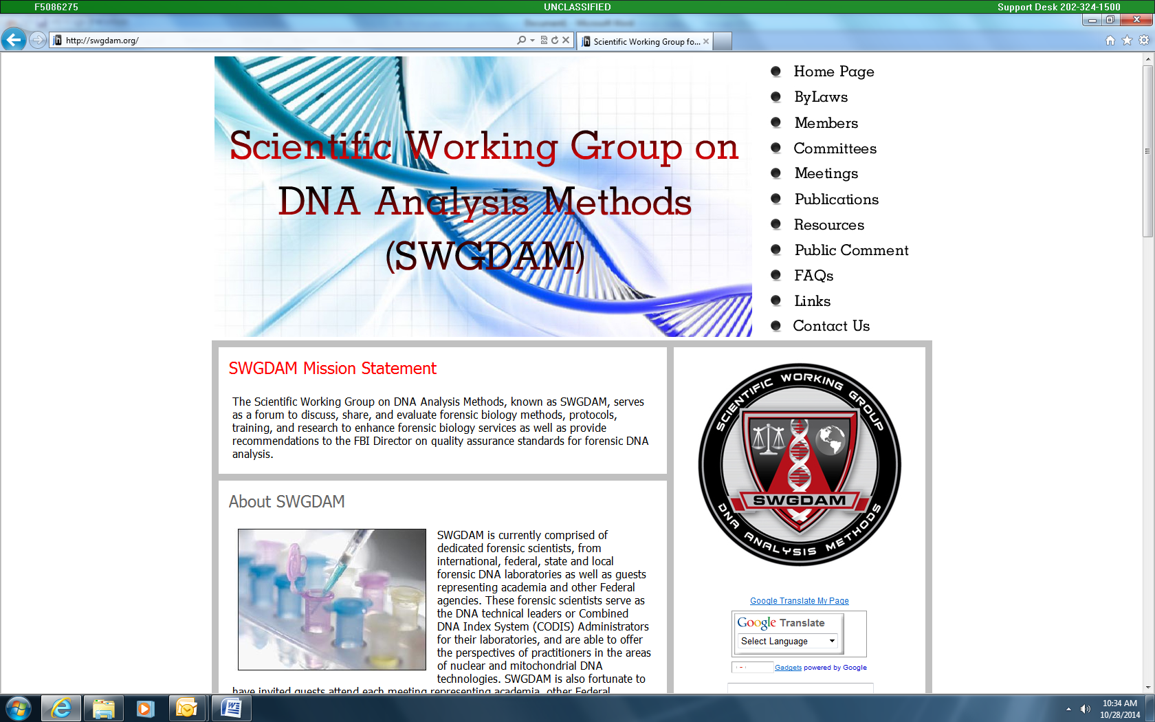
www.swgdam.org

Slide 9
Committee Updates

Slide 10
Committees
Autosomal STR Interpretation
CODIS
Enhanced Detection Methods
Quality Assurance (QA)
Rapid DNA
Y-STR
Autosomal STR Interpretation Committee

Slide 11
Working Groups
Ad Hoc Working Group on Probabilistic Genotyping
Next Generation Sequencing Working Group
Autosomal STR Interpretation Committee

Slide 12
Autosomal STR Interpretation Committee
Autosomal STR Interpretation Committee

Slide 13
Autosomal STR Interpretation
Goals/Objectives
Review and revise as needed the SWGDAM Autosomal STR Interpretation Guidelines

Slide 14
Autosomal STR Interpretation
Tasks/Accomplishments
We held three webinars (Sept 25, Nov 12, and Dec 17) since last meeting
Continued revising 2010 guidelines
  Currently 42 pages (designed a visual executive summary)
  Still have some polishing work to perform
  Re-organizing the document format
Have created an Examples Document
  Currently 50 pages (would like to hyperlink from guidelines document to specific sections)
  Developed to accompany guidelines to provide further guidance on specific mixture issues

Slide 15
Document Reformatting
Executive summary (written & visual)
Twenty-four (XXIV) “fundamental tenets” were moved into front of the document to show essential principles
Committee plans to move most material to appendices for explanatory material and worked examples
  Appendix 1: introduction & analysis issues
  Appendix 2: interpretation & comparison
  Appendix 3a, 3b, 3c: binary statistical models (RMP, LR, CPI)
Worked examples, references and definitions to be self-contained in each appendix

Slide 16
A Visual Executive Summary
Validation studies needed
AT (1.1)
ST (3.2)
Examine the profile and perform quality assessment (Section 1) and determine single-source or mixture path
Stutter thresholds
Recognition of artifacts
Categorize allele peaks (section 2) vs. artifacts (3.1)
Appendix 1
With worked examples
Limit of linearity (off-scale/bleed-through)
Identify the Number of Potential Contributors (3.4)
Peak height ratios (3.3)
Mixture Interpretation Overview and Strategies (3.5)
primary goal should be to determine all possible genotype combinations
Running applicable known mixtures to establish and assess protocols
Assumptions (3.5.1)
2-person (3.5.2)
Major/minor (3.5.4)
Appendix 2
>2-person (3.5.3)
With known contributor (3.5.5)
Potential Stutter (3.5.6)
Prob. Gen.
Compare Reference Samples (3.6)
Population allele frequencies defined and validated for HWE
Reporting requirements (4.1)
For inclusions, determine statistical weight-of-evidence with binary models (4.2)
Software validation to confirm calculations (Section 5)
Appendix
3a, 3b, 3c
RMP (4.2.1)
(5.2.1)
LR (4.2.2) (5.xx)
CPI (4.2.4) (5.xx)
Notes:
For SWGDAM 2015 Revised Interpretation Guidelines Executive Summary

Slide 17
A Few of the “Fundamental Tenets”
(can be adopted into future QAS revisions)
I. (1.1) The Laboratory shall establish an analytical threshold.
XI. (3.5 Intro) The primary goal of mixture interpretation shall be to determine the possible genotype combinations of the contributors.
XIII. (3.5.3) Interpretation guidelines for mixtures of more than two people shall be established based upon validation data from mixtures of more than two contributors.
XXII. (4.1.8) Interpretations that involve the assumption of close biological relatives shall be supported with an appropriate statistical model (i.e., CPI “random man not excluded” shall not be used).

Slide 18
Autosomal STR Interpretation
Pending/Outstanding Issues
Assigned portions of the document to each committee member and we are planning a webinar to discuss document revisions
  March 11, 2015 (1-3 p.m. Eastern)
Plan to have document to the Executive Board by the end of March (aiming for March 24)
Goal to have revised guidelines and examples document for distribution by July 2015 meeting

Slide 19
CODIS
Committee
Autosomal STR Interpretation Committee

Slide 20
CODIS Committee
Objectives:
To identify, evaluate and research issues relating to the use of CODIS in federal, state and local forensic laboratories
  If in the course of the review of such issues, the CODIS committee determines that revisions to the FBI Director’s Quality Assurance Standards for Forensic DNA Testing Laboratories and Convicted Offender DNA Databasing Laboratories are needed, the committee shall recommend such changes to the Chair of SWGDAM for consideration by SWGDAM.
  If the CODIS committee is presented with issues relating to the operation of CODIS, such as software functionality and performance, the committee shall forward such issues and their findings/recommendations through the SWGDAM chair to the Chief of the CODIS Unit.
  The CODIS committee will review issues requested by the NDIS Procedures Board through the SWGDAM chair and will provide their findings and recommendations through the SWGDAM chair to the Board.

Slide 21
CODIS Committee
Tasks/objectives accomplished:
Provided input to the Probabilistic Genotyping Ad Hoc Committee validation document
Began discussions on implementation of the new CODIS Core Loci
Discussed future CODIS conference topics

Slide 22
Enhanced Detection Methods Committee
Autosomal STR Interpretation Committee

Slide 23
EDMI Committee Tasks
Create a SWGDAM guidance document containing guidelines for contamination prevention in forensic DNA testing laboratories.
Review and recommend revisions to the SWGDAM Guidelines for STR Enhanced DNA Detection Methods.
Review and recommend revisions to the FBI’s Quality Assurance Standards (QAS) for the use of DNA typing data generated using LCN analysis by forensic DNA testing laboratories.
Review and recommend revisions to the NDIS Operational Procedures Manual for the interpretation of DNA records and will provide its recommendations to the NDIS Procedures Board.

Slide 24
Contamination Prevention
Brainstorming session about the paper
  Scope: From evidence examination to profile generation.
  Sections: Background/Introduction, Definition of Contamination, Prevention, Detection, interpretation/reporting if detected(?).
  Stress that contamination cannot be eliminated, but can be characterized and managed. As methodologies become more sensitive, minute contaminants can be detected.

Slide 25
Content
Prevention – establish quality practices that include the evaluation of:
  Reagents and consumables
  Controls
  Laboratory cleanliness
  Use of personnel DNA databases
  Use of Personal Protective Equipment

Slide 26
Considerations
A central DNA database for recognized contaminant profiles…?
Collection of elimination samples from investigators.
Types of contamination: case to case, lab staff to case, reagent/consumable to case, non-lab staff to case.

Slide 27
Considerations
QC tests of reagents should be done using the most sensitive assay that the reagent will be used in to see if contamination can be detected.
Provide more guidance on how to perform a contamination assessment during validation.
Must we use the “C word”? “Exogenous DNA?” “Non-targeted DNA.”

Slide 28
Next steps
Assignments to committee members made.
Due back by Friday, February 27th.
Teleconference on Friday, March 6th at 2pm.
Will have a draft for committee discussion for next meeting.

Slide 29
Quality Assurance (QA) Committee
Autosomal STR Interpretation Committee

Slide 30
Committee
Goals/Objectives
Review and evaluate Serology Document public comments
Develop method for receiving QAS revision suggestions from SWGDAM
Discuss issues that arise during audits that may require addressing in the QAS clarification document

Slide 31
Committee
Tasks/Accomplishments of Mtg
Incorporated suggestions received during the public comment period into the SWGDAM Guidelines for the Collection and Serological Examination of Biological Evidence
  Document was reviewed with SWGDAM membership at the January meeting and the Executive Board approved the document for posting on the web site.

Slide 32
Committee
Tasks/Accomplishments
Developed template to receive comments and revision suggestions to the QAS documents from SWGDAM
  Distribution to be determined
Started discussion on topics that need revision.
  Education requirements
  Performance Checks
  Proficiency Testing
  Outsourcing

Slide 33
Committee
Pending/Outstanding Issues
Draft language to submit additions to the QAS Clarification Document to the EB for review
Begin revising the QAS
  Ask the why’s
  Do we need 4 Documents?

Slide 34
Rapid DNA Committee
Autosomal STR Interpretation Committee

Slide 35
Activities
Addendum to QAS to address R-DNA Analysis and Modified R-DNA Analysis – effective Dec 1,2014
Brainstorming on the use of R-DNA in the booking station
R-DNA updates from
  FBI (Lilly) – data/experience with FTA, swabs, blood
  NIST (Pete) - R-DNA maturity assessment
Dawn discussed possible restrictions on the association of DNA and criminal history records (only 9 states)

Slide 36
Brainstorming
Certifying the R-DNA instruments
  How, who, how frequently (breathalyzer model)
Concept of R-DNA TAC (terminal agency coordinator)
  Responsible for training for sample enrollment, follow up on hit notifications
  Liaison for assessment or audits (accountability)
Facilities
  Secure area, stable housing, (a lab will decide?)
Sample control
  Chain of custody (from fingerprint collection, assignment of ID number, correct placement into the R-DNA instrument)
  Waste disposal (biohazard, chemical, regular trash)
  When are you done? After swab is in the instrument? After the cartridges have been properly disposed?

Slide 37
Brainstorming
Performance check
  Frequency?
  Is a NIST traceable material needed?
  Lot checking (similar to lab R-DNA)
  Follow vendor recommendations
  Process control (start to finish) - example
Documentation and reports
  Maintain log files?
  .fsa files – archiving?

Slide 38
Brainstorming
Responsibility for RDIS match notification, follow up, and probable cause sample ?
Discussions with Doug and Tom
  Sharing ideas
  Clarification on topics

Slide 39
NIST R-DNA Maturity Assessment
Initial Results
Rapid DNA Instrument Platforms | Number of Participating Labs | Total Instruments | Samples Attempted | Core CODIS Success (Rapid DNA Analysis) | Core CODIS Success (Modified Rapid DNA Analysis)
2 | 7 | 11 | 280 | 76.1% | 80.0%
Once all results have been analyzed the overall success for the
R-DNA maturity assessment will be reported:
http://www.nist.gov/mml/bmd/genetics/dna_biometrics.cfm
Notes:
*emphasize the software is well tuned, and there is not much of a change between automated and modified analysis
*emphasize that this is not on the website yet!

Slide 40
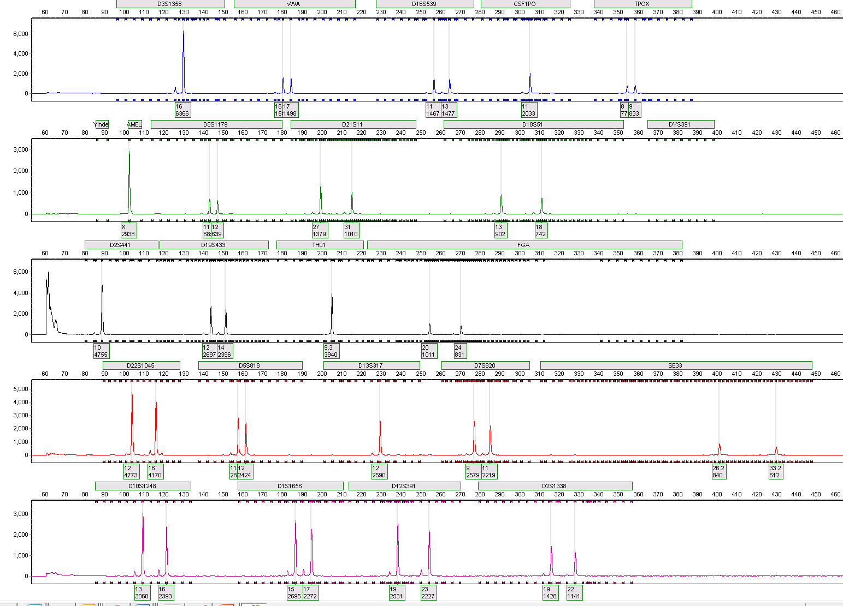
Full Profile GlobalFiler Express
Notes:
74-78%

Slide 41
Y- STR Committee
Autosomal STR Interpretation Committee

Slide 42
Committee
Goals/Objectives
Primary goal is to supplement the Y-STR Guidelines (2014) to address indistinguishable mixtures & evidential minor contributor

Slide 43
Committee
Tasks/Accomplishments of Mtg
  The committee agreed to pursue a likelihood ratio-based probabilistic approach that accommodates allele drop out/drop in (or fully continuous)

Slide 44
Committee
Pending/Outstanding Issues
Y mixture tool developed by Steven Myers that considers silent alleles, multiple alleles, stutter & variable dropout
Other Y tools available at the US Y-STR database site at https://www.usystrdatabase.org/

Slide 45
Committee
Pending/Outstanding Issues
Next Steps
Alpha testing of the Y mixture tool developed by Steven Myers
Continue with development of Y-STR mixture interpretation guidelines

Slide 46
Ad Hoc Working Group on Probabilistic Genotyping
Autosomal STR Interpretation Committee

Slide 47
Working Group
Tasks/Accomplishments of Mtg
  Draft of the Guidelines for the Validation of Probabilistic Genotyping Systems was presented to the attendees of the January SWGDAM meeting.
  Technical Review period by membership and invited guests during January/February 2015.

Slide 48
Next Generation Sequencing Working Group
Autosomal STR Interpretation Committee

Slide 49
Tasks
The NGS Working Group will monitor the development of NGS and its potential forensic applications and considerations such as nomenclature standardization for CODIS use and make regular reports to the SWGDAM Membership.
The NGS Working Group will generate and review performance data using forensic applications of NGS and make regular reports to the SWGDAM Membership.
The NGS Working Group will review and, if necessary, recommend revisions to the FBI’s Quality Assurance Standards (QAS) for the use of DNA typing data generated using NGS analysis by forensic DNA testing laboratories.
The NGS Working Group will review and, if necessary, recommend revisions to the NDIS Operational Procedures Manual for the interpretation of DNA records generated by NGS and will provide its recommendations to the NDIS Procedures Board via the SWGDAM Chair.

Slide 50
Activity
Reviewed research progress of member labs
Discussed ethical issues surrounding NGS (Katsanis)
Nomenclature & Search Strategies: ENFSI panel created to discuss topic. We recommend inviting additional representative.

Slide 51
Member Research
Battelle inter-lab study (about to begin)
Body fluid ID combined with DNA type
mtDNA assays (CR, full genome)
“Fusion” NGS kit evaluation
Beta test of Forens-Seq Kit (Illumina – STRs, phenotypic and ancestry SNPs)
Basic research

Slide 52
Future Directions
FSI-G issue with NGS article(s) in July 2015
Nomenclature (in coordination with ENFSI)
CODIS discussions
  Loci?
  Searching strategies?
Member survey of issues to be addressed prior to implementation of NGS in crime labs

Slide 53
SWGDAM Contact
SWGDAM Chair
Tony Onorato
202-369-2389
Anthony.Onorato@ic.fbi.gov

